Slide 1
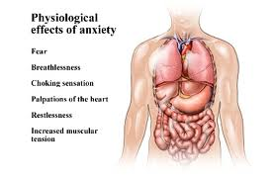
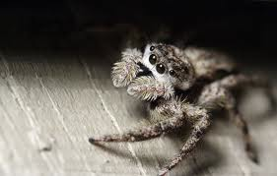
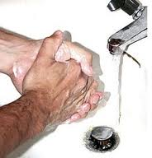
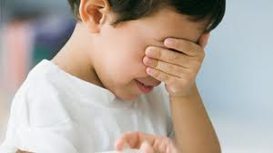
Anxiety Disorders
MHS – Psychology - 2013

Slide 2
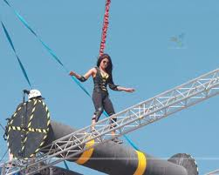
Fear
In the short-term, it’s a good thing…
Fear keeps you alive
When it gets out of control… it’s a disorder
3 main types:
Generalized anxiety disorder
Phobias
Obsessive compulsive disorder

Slide 3
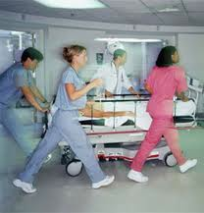
Generalized Anxiety (G-A-D)
Definition:
Continuous, uncontrollable feelings of dread
Must last for at least 6 months
Can’t be caused by drugs, coffee, etc.
Symptoms:
Restless, irritable, can’t concentrate
Fatigue (trouble sleeping)
Predisposing factors:
Genetics, poor coping skills, traumatic events
Slow-paced person working in an emergency room

Slide 4
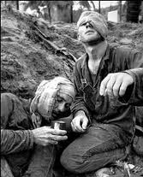
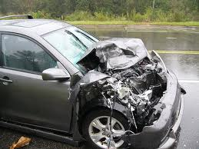
2 types of GAD
PTSD (post-traumatic stress disorder)
War, rape, natural disasters…
Symptoms may only start after a couple of months…
Acute Stress disorder
Happens right away & goes away after a few months…
Symptoms for both:
Reliving the trauma over and over
Feeling ‘numb,’ detached from others
Feeling ‘on edge’, trouble sleeping

Slide 5
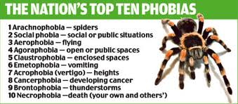
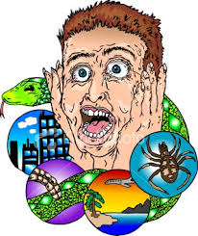
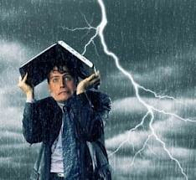
Phobias
Unrealistic fear of a specific situation or thing
Common ones:
Acrophobia (heights)
Claustrophobia (closed spaces)
Mysophobia (dirt & germs)
Zoophobia (snakes, insects, dogs, mice)
Brontophobia (thunder)

Slide 6
Agoraphobia
More than half of all the cases where people seek treatment of a phobia…
Not a fear of open spaces (dictionary)
It’s the fear of being away from a safe place… of being in a public space from which escape may be difficult and help unavailable
It’s a fear of fear, more than a fear of places

Slide 7
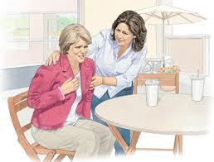
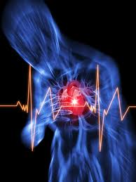
Panic Attacks (Disorder)
Intense fear / terror and sense of doom
Lasts minutes
Usually with
Shaking, Dizzyness, Sweating
Heart palpitations, Chest pain
Fear of losing control / dying
Runs in families
Stress, exercise, caffeine… increase chances
‘Normal’ to have a panic attack… panic disorder is when it happens regularly.

Slide 8
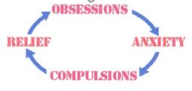
Obsessions and Compulsions (OCD)
Obsessions:
thoughts / images that keep coming back
Sometimes disturbing (hurting people)
Compulsions
Repetitive, ritualized behaviors
Hand washing, counting, touching, checking
Know it doesn’t make sense, but still can’t stop!

