Slide 1
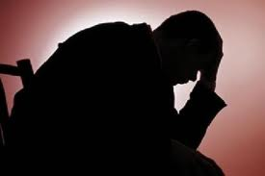
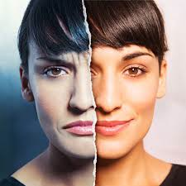
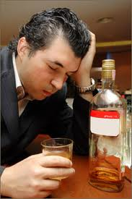
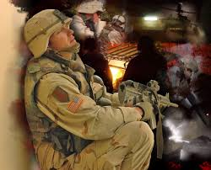
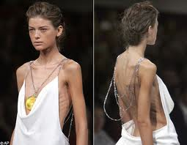
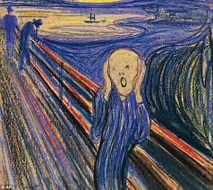
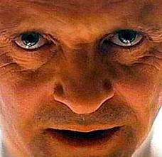
Mental Disorders
MHS – Psychology - 2012

Slide 2
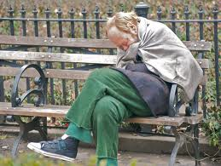
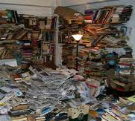
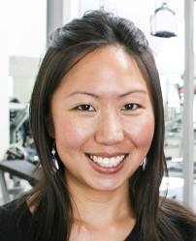
Where do we find mental disorders?
Homeless… 25 – 30 % (schizo)
Prisons… 50 % (personality)
TV… strange addictions, hoarders
Right next to you…
‘Abnormal doesn’t mean ‘insane,’ ‘crazy,’ or ‘sick’
1st rule: No exact line where normal ends and ‘different’ begins (same problems, diff. intensity)

Slide 3
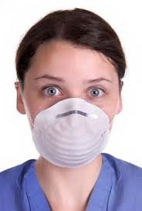
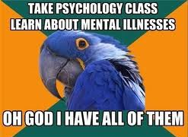
“Am I normal?”
One of the most common worries
It’s normal to experience feelings that people don’t understand you / your situation
Medical Students’ Syndrome:
Deciding you suffer from whatever disease you are reading about

Slide 4
A mental disorder is when someone
Breaks the social community rules
Like wearing clothes or not committing murder
Hallucinations not always a violation…
Today → schizophrenia
13th Century monk → Desireable (Joan of Arc)
The point: culture is important!!!

Slide 5
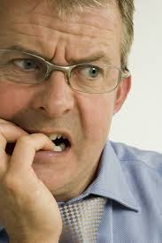
A mental disorder is when someone
Disruptive (hurt) themselves / the community
Fear of crowds… don’t leave house
Anxious about failure… can’t write exam
Gambler loses family savings

Slide 6
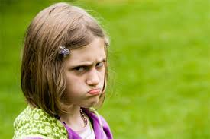
A mental disorder is when someone
Is emotionally distressed
Conform to society’s rules… but still
Feel angry, depressed, anxious, guilty

Slide 7
Insanity
Is insane: Legal
Insanity is only a legal term… no doctors use it
1) Is he aware of the consequences of his actions?
2) Can he control his behavior?

Slide 8
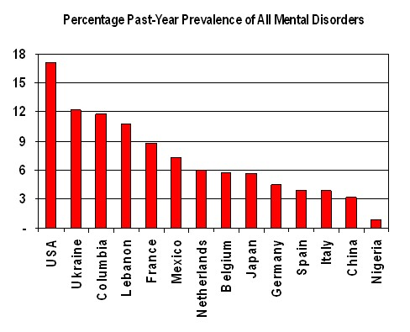
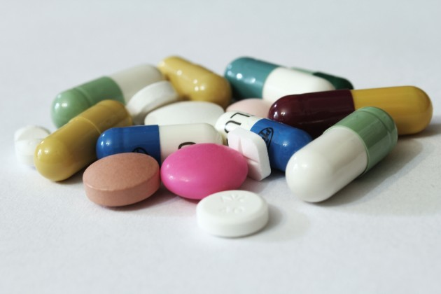
What is a mental disorder?
It’s a behavior or emotional state that
Disrupts relationships in the community
Is self-destructive
Causes emotional suffering
Many people have some form of mental health problem in their lifetime… its ‘normal’

Slide 9
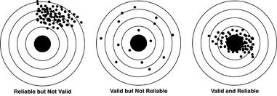
How do we diagnose mental disorders?
Questionnaires
Standardized questions with MC / TF answers.
(Beck Depression, Taylor Anxiety, MMPI)
Good reliability (consistent over time)
Good validity (measures what it is supposed to)
Therapists
Makes judgments, less reliable over time, but…
Can deal with lying, non-verbal cues, etc.

Slide 10
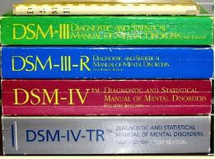
The DSM
The bible for mental illness
Signs / symptoms
Predisposing factors
Course of the disorder
Bigger every year: why?
Insurance companies only pay for illnesses in the bible…
Doctors want to get paid to help people, so
Doctors make changes to the DSM to companies will pay

Slide 11
Problems with the DSM
Law of the instrument
Give a kid a hammer, he finds things to pound
Give DSM… people get ‘diagnosed’
Before 1980: less than 200 cases of MPD multiple person.
After added to DSM-III: 30 000 cases of MPD
Labels stick (see illness not person)
‘Borderline schizophrenic’ people treat you like a schizo. Instead of looking for actual behavior

Slide 12
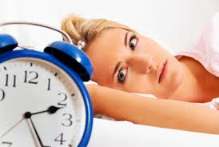
Confuse mental disorders with normal problems
Mathematics disorder (trouble with math)
Caffeine-induced sleep disorder (duh)
Diagnosis takes away responsibility
Paraphilic coercive disorder… later dropped
Rapists… not my fault, I have a disorder!

Slide 13
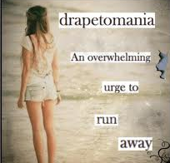
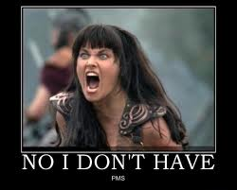
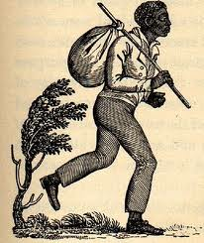
Make subjective look objective
Drapetomania (urge to run → slavery)
Premenstrual Dysphoric Disorder
Diagnoses made by community reflect cultural ideas of what mental illness is and change with time

Slide 14
Major Categories in the DSM
Childhood → ADHD
Dementia → Alzheimers
Substance → Alcohol, caffeine, cocaine
Psychotic → Schizophrenia
Mood → Depression, bipolar
Anxiety → PTSD, panic
Somatoform → Hypochondria
Dissociative → Amnesia, MPD
Sexual → Paraphilias
Impulse control → Kleptomania, pyromania
Personality → Narcissistic, Antisocial

