Slide 1
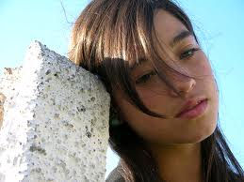
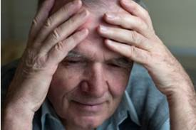
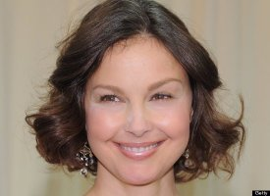
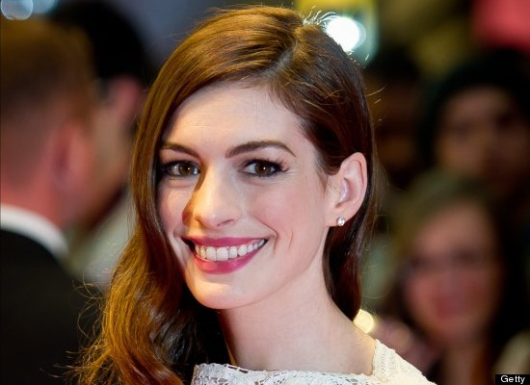
Mood Disorders
MHS – PSYCHOLOGY - 2013

Slide 2
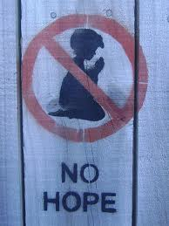
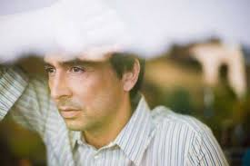
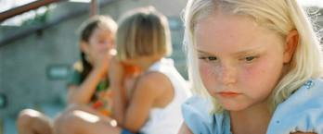
Depression: More than just ‘the blues’
Depression is not a sign of personal weakness
Can’t just “pull yourself together.”
Physical illness involving frequent episodes of
intense hopelessness (never get better)
lowered self-esteem (don’t belong, no one understands)
Left untreated, depression may lead to suicide.

Slide 3
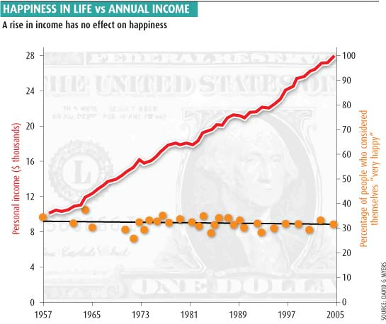
Most common mood disorder
Estimated that 17 percent of the U.S. pop
5-12 percent of men (under-reported?)
10-20 percent of women
will suffer from a major
depressive episode at least
once in their lifetime
Mo’ $ → Mo’ problems?

Slide 4
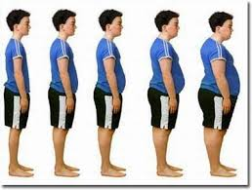
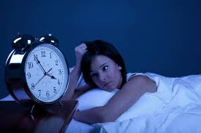
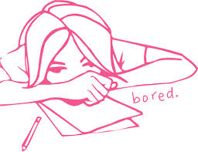
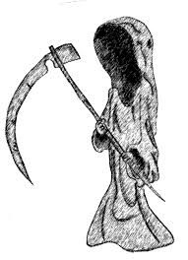
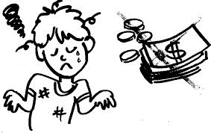
DSM DIAGNOSIS
You need at least 5 of these 9 symptoms during the same two-week period:
1. Depressed mood (everything flat…)
2. Reduced interest in almost all activities
3. Significant weight gain or weight loss
4. Insomnia, or sleeping too much
5. Increased or decreased motor activity (twitchy, sluggish)
6. Fatigue or loss of energy
7. Feelings of worthlessness or guilt
8. Reduced ability to concentrate or think
9. Recurrent thoughts of death

Slide 5
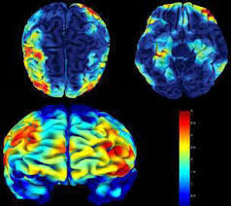
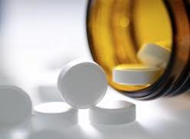
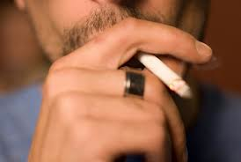
Predictive factors
Depression is more likely to co-occur with certain
medical illnesses (stroke, heart disease, cancer, diabetes)
psychiatric disorders (anxiety and eating disorders)
substance abuse disorders
Those who have a family history can inherit a biological vulnerability for depression.
Lack of serotonin → increase in depression
Rates are especially high for people suffering from PTSD – stress related

Slide 6
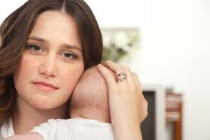
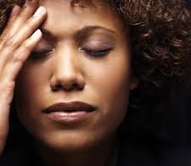
Gender
Women are 2 to 3 times more likely to experience depression.
1 in 5 women
The causes in women are not primarily biological.
infertility, miscarriages, and surgical menopause can cause symptoms
POSTPARTUM:
Mothers of young children tend to be very vulnerable to depression
Changes in hormones or stress, or both?

Slide 7
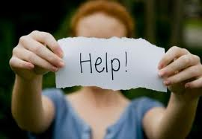
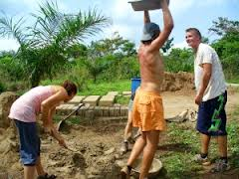
Treatment
Drug therapy may be necessary (MAOIs, lithium)
Depression makes a person feel
exhausted, helpless, and worthless
Important to realize your view is distorted
No important decisions
Get involved in social activities (go to work, volunteer)
Mild exercise

Slide 8
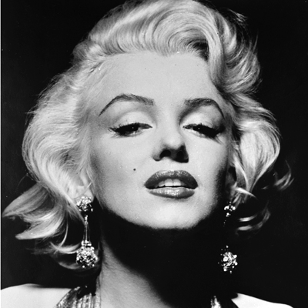
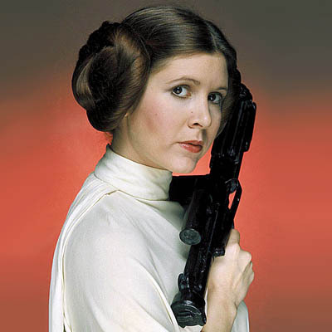
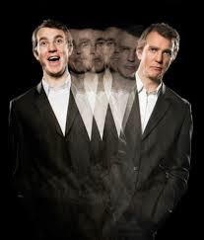
Bipolar Disorder (Manic-Depression)
Alternate between phases of depression and mania…
Common signs and symptoms of MANIA:
Feeling unusually optimistic OR extremely irritable (picking fights)
Grandiose beliefs about one’s abilities
Sleeping very little, but feeling extremely energetic
Talking so rapidly that others can’t keep up
Racing thoughts; jumping quickly from one idea to the next
Highly distractible, unable to concentrate
Impaired judgment and impulsiveness (gambling, sexual)
Delusions and hallucinations (in severe cases)

